Slide 1
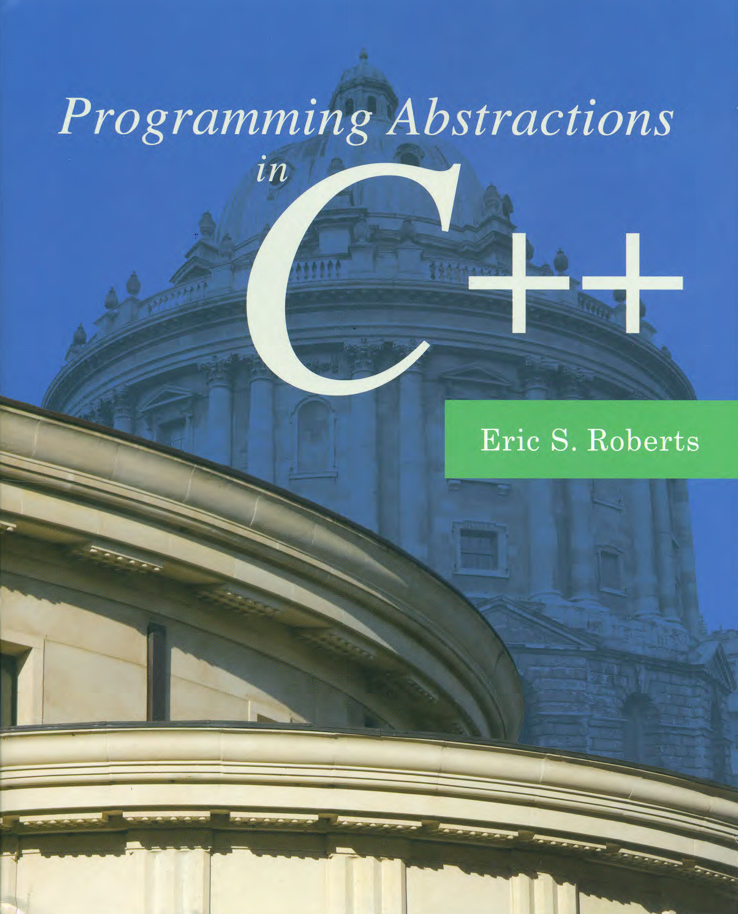
Collections
C H A P T E R 5
In this way I have made quite a valuable collection.
—Mark Twain, A Tramp Abroad, 1880
5.1 The collection classes
5.2 The Vector class
5.3 The Stack class
5.4 The Queue class
5.5 The Map class
5.6 The Set class
5.7 Iterating over a collection

Slide 2
Introduction to the C++ Libraries
A collection of classes and functions, which are written in the core language and part of the C++ ISO Standard (98/11) itself. Features of the C++ Standard Library are declared within the std namespace
Containers: vector, list, stack, queue, map, set, etc.
General: algorithm, functional, iterator, memory, etc.
Strings
Streams and Input/Output: iostream, fstream, sstream, etc.
Localization
Language support
Thread support library
Numerics library
C standard library: cmath, cctype, cstring, cstdio, cstdlib, etc.

Slide 3
Abstract Data Type (ADT)
The atomic/primitive data types like bool, char, int, double, and the enumerated types (enum) occupy the lowest level in the data structure hierarchy.
To represent more complex information, you combine the atomic types to form larger structures.
It is usually far more important to know how to use those structures effectively than to understand their underlying representation, e.g., using strings as abstract values (Ch. 3).
A type defined in terms of its behavior rather than its representation is called an Abstract Data Type (ADT).
ADTs are central to the object-oriented style of programming, which encourages programmers to think about data structures in a holistic way.

Slide 4

ADTs as Software Tools
Over the relatively short history of software development, one of the clear trends is the increasing power of the tools available to you as a programmer.
One of the best explanations of the importance of tools is the book Software Tools by Brian Kernighan and P. J. Plauger. Even though it was published in 1976, its value and relevance have not diminished over time.
The primary theme of the book is that the best way to extend your reach in programming is to build on the tools of others.

Slide 5
The Collection Classes
The classes that contain collections of other objects are called containers or collection classes.
Collection classes specify the type of objects they contain (base/element type) by including the type name in angle brackets following the class name.
Separating the behavior of a class from its underlying implementation is a fundamental precept of object-oriented programming. As a design strategy, it offers the following advantages:
Simplicity: fewer details for the client to understand.
Flexibility: free to change underlying implementation as long as the interface remains the same.
Security: prevents the client from changing the values in the underlying data structure in unexpected ways.

Slide 6
Principles of Interface Design
Flashback
Unified. Every library should define a consistent abstraction with a clear unifying theme. If a function does not fit within that theme, it should not be part of the interface.
Simple. The interface design should simplify things for the client. To the extent that the underlying implementation is itself complex, the interface must seek to hide that complexity.
Sufficient. For clients to adopt a library, it must provide functions that meet their needs. If some critical operation is missing, clients may decide to abandon it and develop their own tools.
Flexible. A well-designed library should be general enough to meet the needs of many different clients. A library that offers narrowly defined operations for one client is not nearly as useful as one that can be used in many different situations.
Stable. The functions defined in a class exported by a library should maintain precisely the same structure and effect, even as the library evolves. Making changes in the behavior of a library forces clients to change their programs, which reduces its utility.

Slide 7
The Stanford Collection Classes
The Stanford C++ Library includes the simplified version of such containers of the Standard C++ Libraries, such as:
Here are some general guidelines for using these classes:
These classes represent ADTs whose details are hidden.
Each class (except Lexicon) requires type parameters.
Declaring variables of these types always invokes a class constructor.
Any memory for these objects is freed (automatically) when its declaration scope ends.
Assigning one value to another copies the entire structure.
To avoid copying, these structures are usually passed by reference.
Vector
Grid
Stack
Queue
Map
Set
Lexicon

Slide 8
The Standard Collection Classes
Classes that include a base-type specification are called parameterized classes.
In C++, parameterized containers are implemented as template classes, which make it possible for an entire family of classes to share the same code, although their base types are different.
The Standard Template Library (STL) is a software library for the C++ programming language that influenced many parts of the C++ Standard Library.
Although the C++ Standard Library and the STL share many features, neither is a strict superset of the other.
Templates are sometimes called static (or compile-time) polymorphism, as opposed to run-time polymorphism.
For the moment, you don’t need to understand how these classes are implemented using templates, because your primary focus is on learning how to use these classes as a client.

Slide 9
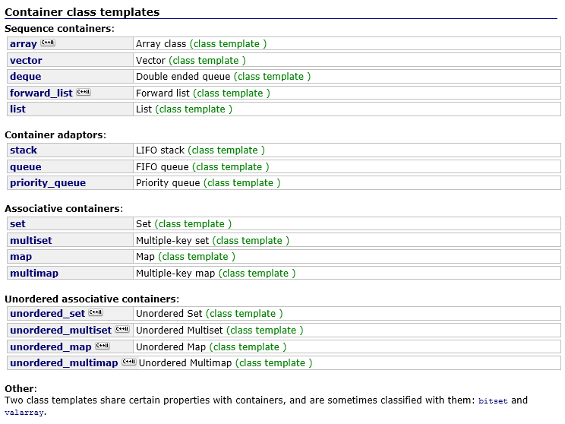
C++ Standard Containers

Slide 10
The Vector<type> Class
The Vector class provides a facility similar to list in Python, and the underlying implementation is based on array in C++.
Besides including the appropriate library interface, as a client of the Vector class, you are concerned with a different set of issues and need to answer the following questions:
How is it possible to specify the type of object (base/element type) contained in a Vector?
How does one create an object that is an instance of the Vector class (declaration)?
What methods exist in the Vector class to implement its abstract behavior?
#include "vector.h"

Slide 11
Constructors for the Vector<type> Class
Vector<type> vec;
Initializes an empty vector of the specified element type.
Vector<type> vec(n);
Initializes a vector with n elements all set to the default value of the type.
Vector<type> vec(n, value);
Initializes a vector with n elements all set to value.
Instead of using the class name alone, the collection classes require a type parameter that specifies the element type. For example, Vector<int> represents a vector of integers. Similarly, Grid<char> represents a two-dimensional vector of characters.

Slide 12
Declaring a Vector object
It is possible to nest classes, so that, for example, you could use the following definition to represent a list of chess positions:
The Stanford C++ library implementation of Vector includes a shorthand form for initializing an array given a list of values, as illustrated by the following example:
Vector< Grid<char> > chessPositions;
Vector<int> digits;
digits += 0, 1, 2, 3, 4, 5, 6, 7, 8, 9;

Slide 13
Methods in the Vector<type> Class
vec.size()
Returns the number of elements in the vector.
vec.isEmpty()
Returns true if the vector is empty.
vec.get(i) or vec[i]
Returns the i^{th} element of the vector.
vec.set(i, value) or vec[i] = value;
Sets the i^{th} element of the vector to value.
vec.add(value) or vec += value;
Adds a new element to the end of the vector.
vec.insertAt(index, value)
Inserts the value before the specified index position.
vec.removeAt(index)
Removes the element at the specified index.
vec.clear()
Removes all elements from the vector.

Slide 14
The Vector<type> Class Operators
#include "vector.h“
Vector<int> vec;
vec.add(10); // vec += 10;
vec.add(20);
vec.add(40);
vec.add(50);
vec.insertAt(2, 30);
vec.removeAt(0);
vec.set(3, 70); // vec[3] = 70;
Notes:
Show examples: VectorOperators, PrintVector, ReverseFile, LetterFrequency

Slide 15
The readEntireFile Function
/*
* Function: readEntireFile
* Usage: readEntireFile(is, lines);
* ---------------------------------
* Reads the entire contents of the specified input stream
* into the string vector lines. The client is responsible
* for opening and closing the stream
*/
void readEntireFile(istream & is, Vector<string> & lines) {
lines.clear(); // be careful
string line;
while (true) {
getline(is, line);
if (is.fail()) break;
lines.add(line);
}
}

Slide 16
The readEntireFile Function
/*
* Function: readEntireFile
* Usage: readEntireFile(is, lines);
* ---------------------------------
* Reads the entire contents of the specified input stream
* into the string vector lines. The client is responsible
* for opening and closing the stream
*/
void readEntireFile(istream & is, Vector<string> & lines) {
lines.clear();
string line;
while (getline(is, line)) {
lines.add(line);
}
}

Slide 17
Methods in the Grid<type> Class
Grid<type> grid(nrows, ncols);
Constructs a grid with the specified dimensions.
grid.numRows()
Returns the number of rows in the grid.
grid.numCols()
Returns the number of columns in the grid.
resize(nrows, ncols)
Changes the dimensions of the grid and clears any previous contents.
inBounds(row, col)
Returns true if the specified row and column position is within the grid.
get(i, j) or grid[i][j]
Returns the element at the specified row and column.
set(i, j, value) or grid[i][j] = value
Sets the element at the specified row and column to the new value.
grid[i][j]
Selects the element in the i^{th} row and j^{th} column.
Notes:
Show examples: TicTacToeCheck, TicTacToeGrid

Slide 18



The Stack Metaphor
A stack is a data structure in which the elements are accessible only in a Last In, First Out (LIFO) order.
The fundamental operations on a stack are push, which adds a new value to the top of the stack, and pop, which removes and returns the top value.
One of the most common metaphors for the stack concept is a spring-loaded storage tray for dishes. Adding a new dish to the stack pushes any previous dishes downward. Taking the top dish away allows the dishes to pop back up.
In programming, nested function calls behave in a stack-oriented fashion.

Slide 19
Methods in the Stack<type> Class
stack.size()
Returns the number of values pushed onto the stack.
stack.isEmpty()
Returns true if the stack is empty.
stack.push(value)
Pushes a new value onto the stack.
stack.pop()
Removes and returns the top value from the stack.
stack.peek()
Returns the top value from the stack without removing it.
stack.clear()
Removes all values from the stack.

Slide 20
Example: RPN Calculator
In Reverse Polish Notation, operators are entered after the operands to which they apply. It does not need any parentheses as long as each operator has a fixed number of operands, and utilizes the stack to evaluate expressions, therefore reduces computer memory access. For example, to compute the result of the expression 8.5 * 4.4 + 6.9 / 1.5 on an RPN calculator, you would enter the operations in the following order:
Notes:
Show example RPNCalculator

Slide 21

Exercise: Stack Processing
Write a C++ program that checks whether the bracketing operators (parentheses, brackets, and curly braces) in a string are properly matched. As an example of proper matching, consider the string
If you go through the string carefully, you discover that all the bracketing operators are correctly nested, with each open parenthesis matched by a close parenthesis, each open bracket matched by a close bracket, and so on.
{ s = 2 * (a[2] + 3); x = (1 + (2)); }
IsBalanced
Enter string:
{ s = 2 * (a[2] + 3); x = (1 + (2)); }
Brackets are properly nested
Enter string:
(a[2] + b[3)
Brackets are incorrect
Enter string:
Notes:
Show example IsBalanced

Slide 22
The Queue<type> Class
The LIFO discipline in a stack is useful in programming contexts because it reflects the operation of function calls.
In real-world situations, however, our collective notion of fairness assigns some priority to being first. In programming, the usual phrasing of this ordering strategy is First In, First Out (FIFO).
A data structure that stores items using a FIFO discipline is called a queue. The fundamental operations on a queue, which are analogous to the push and pop operations for stacks, are called enqueue and dequeue.
The enqueue operation adds a new element to the end of the queue, which is traditionally called its tail.
The dequeue operation removes the element at the beginning of the queue, which is called its head.

Slide 23
Comparing Stacks and Queues
C
B
A
push
Stack:
pop
A
B
C
enqueue
Queue:
dequeue

Slide 24
Methods in the Queue<type> Class
queue.size()
Returns the number of values in the queue.
queue.isEmpty()
Returns true if the queue is empty.
queue.enqueue(value)
Adds a new value to the end of the queue (which is called its tail).
queue.dequeue()
Removes and returns the value at the front of the queue (which is called its head).
queue.peek()
Returns the value at the head of the queue without removing it.
queue.clear()
Removes all values from the queue.

Slide 25
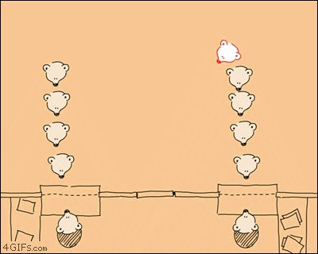
Example: Simulate a checkout line
One cashier is serving customers from a single queue.
Customers arrive with a random probability and enter the queue at the end of the line.
Whenever the cashier is free and someone is waiting in line, the cashier begins to serve that customer.
After an appropriate service period, the cashier completes the transaction with the current customer, and is free to serve the next customer in the queue.

Slide 26
Example: Simulate a checkout line
The core of the simulation is a loop that runs for the number of seconds indicated by the parameter SIMULATION_TIME. In each second, the simulation performs the following operations:
Determine whether a new customer has arrived according to a certain probability ARRIVAL_PROBABILITY, and, if so, add that person to the queue.
If the cashier is busy, note that the cashier has spent another second with the current customer. Eventually, the required service time will be complete, which will free the cashier.
If the cashier is free, serve the next customer in the waiting line, for a certain amount of time, randomly chosen between MIN_SERVICE_TIME and MAX_SERVICE_TIME.
Notes:
Show example: CheckoutLine

Slide 27
The Map<type, type> Class
A map is conceptually similar to a dictionary in real life (and in Python), which allows you to look up a word to find its meaning.
The Map class is a generalization of this idea that provides an association between an identifying tag called a key (e.g., the word in a dictionary) and an associated value (e.g., the definition of the word in the dictionary), which may be a much larger and more complicated structure.
Map declaration:
The type for the keys stored in a Map must define a natural ordering, usually through a less function and/or < operator so that the keys can be compared and ordered.
E.g., two most commonly used maps:
Map<key type, value type> map;
Map<string, string> dictionary;
Map<string, double> symbolTable;

Slide 28
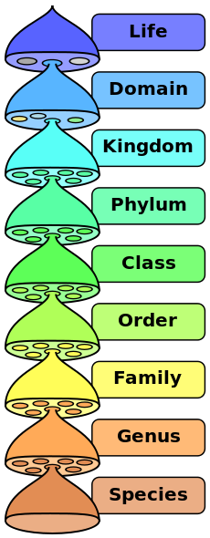
The Map of Biological Taxonomic Rank
Key | Value
Life | Life is the characteristic that distinguishes organisms from inorganic substances and dead objects.
Domain | In biological taxonomy, a domain is the highest taxonomic rank of organisms…
Kingdom | In biology, kingdom is the third highest taxonomic rank, just below domain…
Phylum | In biology, a phylum is a taxonomic rank below kingdom and above class…
Class | …
Order | …
Family | …
Genus | …
Species | …

Slide 29
Methods in the Map Classes
A map associates keys and values. The Stanford library offers two flavors of maps, Map and HashMap (more about hash later), both of which implement the following methods:
map.size()
Returns the number of key/value pairs in the map.
map.isEmpty()
Returns true if the map is empty.
map.put(key, value) or map[key] = value;
Makes an association between key and value, discarding any existing one.
map.get(key) or map[key]
Returns the most recent value associated with key.
map.containsKey(key)
Returns true if there is a value associated with key.
map.remove(key)
Removes key from the map along with its associated value, if any.
map.clear()
Removes all key/value pairs from the map.

Slide 30
Using Maps in an Application
The AirportCodes.cpp program reads a file associating three-letter airport codes with their locations into a Map<string, string>, where it can be more easily used.
The association list is stored in a text file that looks like this:
The program runs like this:
PEK=Beijing, China
NAY=Beijing, China
SHA=Shanghai, China
PVG=Shanghai, China
SZX=Shenzhen, China
SFO=San Francisco, CA, USA
LHR=London, England, United Kingdom
...
Notes:
Show example: Airports

Slide 31
AirportCodes.cpp
int main() {
Map<string,string> airportCodes;
readCodeFile("AirportCodes.txt", airportCodes);
while (true) {
string line;
cout << "Airport code: ";
getline(cin, line);
if (line == "") break;
string code = toUpperCase(line);
if (airportCodes.containsKey(code)) {
cout << code << " is in " << airportCodes.get(code) << endl;
} else {
cout << "There is no such airport code" << endl;
}
}
return 0;
}
void readCodeFile(string filename, Map<string,string> & map) {
ifstream infile;
infile.open(filename.c_str());
if (infile.fail()) error("Can't read the data file");
string line;
while (getline(infile, line)) {
if (line.length() < 4 || line[3] != '=') {
error("Illegal data line: " + line);
}
string code = toUpperCase(line.substr(0, 3));
map.put(code, line.substr(4));
}
infile.close();
}

Slide 32
Exercise: Symbol Tables
A map is often called a symbol table when it is used in the context of a programming language, because it is precisely the structure you need to store variables and their values.
For example, if you are working in an application in which you need to assign floating-point values to variable names, you could do so using a map declared as follows:
Write a C++ program that declares such a symbol table and then reads in command lines from the user, which must be in one of the following forms:
A simple assignment statement of the form var = number.
A variable alone on a line, which is a request to display its value.
The command list, which lists all the variables.
The command quit, which exits from the program.
Map<string,double> symbolTable;
Notes:
Show example: SymbolTableTest and SymbolTableTestMap

Slide 33
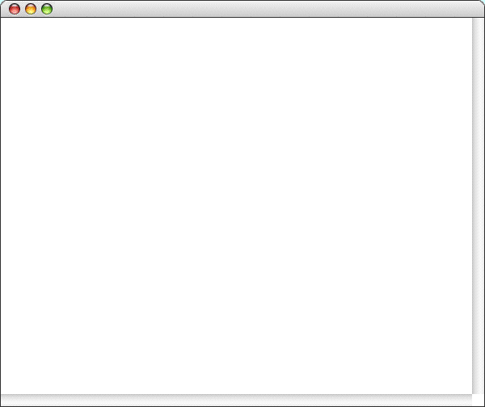
Symbol Table Sample Run
SymbolTableTest
>
pi = 3.14159
>
e = 2.71828
>
x = 2.00
>
pi
3.14159
>
x
2
>
list
e = 2.71828
pi = 3.14159
x = 2
>
x = 42
>
a = 1.5
>
list
a = 1.5
e = 2.71828
pi = 3.14159
x = 42
>
quit

Slide 34
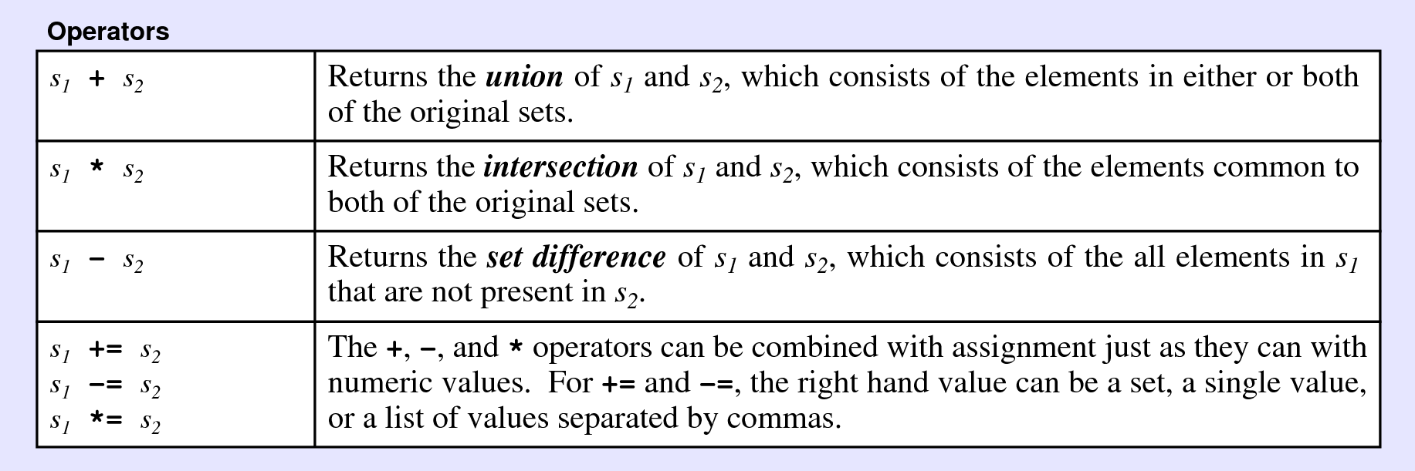
The Set<type> Class
This class is used to model the mathematical abstraction of a set, which is a collection in which the elements are unordered and in which each value appears only once (no duplicate).
Set supports several mathematical operations (via operator overloading) based on mathematical set theory, in addition to the usual methods exported by the other collection classes.

Slide 35
Methods in the Set<type> Class
set.size()
Returns the number of elements in the set.
set.isEmpty()
Returns true if the set is empty.
set.add(value)
Adds value to the set.
set.remove(value)
Removes value from the set.
set.contains(value)
Returns true if the set contains the specified value.
set.clear()
Removes all words from the set.
s1.isSubsetOf(s2)
Returns true if s1 is a subset of s2.
set.first()
Returns the first element of the set in the ordering specified by the value type.

Slide 36
The <cctype> (ctype.h) Interface
Flashback
bool isdigit(char ch)
Determines if the specified character is a digit.
bool isalpha(char ch)
Determines if the specified character is a letter.
bool isalnum(char ch)
Determines if the specified character is a letter or a digit.
bool islower(char ch)
Determines if the specified character is a lowercase letter.
bool isupper(char ch)
Determines if the specified character is an uppercase letter.
bool isspace(char ch)
Determines if the specified character is whitespace (spaces and tabs).
char tolower(char ch)
Converts ch to its lowercase equivalent, if any. If not, ch is returned unchanged.
char toupper(char ch)
Converts ch to its uppercase equivalent, if any. If not, ch is returned unchanged.

Slide 37
Implementing the <cctype> Library
Set-based implementation of the <cctype> (Ch. 3) Library:
const Set<char> DIGIT_SET =
setFromString("0123456789");
const Set<char> LOWER_SET =
setFromString("abcdefghijklmnopqrstuvwxyz");
const Set<char> UPPER_SET =
setFromString("ABCDEFGHIJKLMNOPQRSTUVWXYZ");
const Set<char> PUNCT_SET =
setFromString("!\"#$%&'()*+,-./:;<=>?@[\\]^_`{|}~");
const Set<char> SPACE_SET =
setFromString(" \t\v\f\n\r");
const Set<char> XDIGIT_SET =
setFromString("0123456789ABCDEFabcdef");
const Set<char> ALPHA_SET =
LOWER_SET + UPPER_SET;
const Set<char> ALNUM_SET =
ALPHA_SET + DIGIT_SET;
const Set<char> PRINT_SET =
ALNUM_SET + PUNCT_SET + SPACE_SET;
Notes:
Show example CCType

Slide 38
Implementing the <cctype> Library
Set-based implementation of the <cctype> (Ch. 3) Library:
Set<char> setFromString(string str) {
Set<char> set;
for (int i = 0; i < str.length(); i++) {
set.add(str[i]);
}
return set;
}
bool isalnum(char ch) { return ALNUM_SET.contains(ch); }
bool isalpha(char ch) { return ALPHA_SET.contains(ch); }
bool isdigit(char ch) { return DIGIT_SET.contains(ch); }
bool islower(char ch) { return LOWER_SET.contains(ch); }
bool isprint(char ch) { return PRINT_SET.contains(ch); }
bool ispunct(char ch) { return PUNCT_SET.contains(ch); }
bool isspace(char ch) { return SPACE_SET.contains(ch); }
bool isupper(char ch) { return UPPER_SET.contains(ch); }
bool isxdigit(char ch) { return XDIGIT_SET.contains(ch); }
Notes:
Show example CCType

Slide 39
The Lexicon Class
A set of words with no associated definitions is called a lexicon.
Create an English word list using Set with the following code:
Or simply:
.dat is a space-efficient precompiled binary format of text files.
Set<string> english;
ifstream infile;
infile.open("EnglishWords.txt");
if (infile.fail())
error("Can't open EnglishWords.txt");
string word;
while (getline(infile, word)) {
english.add(word);
}
infile.close();
Lexicon english("EnglishWords.dat");
Notes:
Show example SetBasedLexicon

Slide 40
Methods in the Lexicon Class
lexicon.size()
Returns the number of words in the lexicon.
lexicon.isEmpty()
Returns true if the lexicon is empty.
lexicon.add(word)
Adds word to the lexicon, always in lowercase.
lexicon.addWordsFromFile(filename)
Adds all the words in the specified file to the lexicon.
lexicon.contains(word)
Returns true if the lexicon contains the specified word.
lexicon.containsPrefix(prefix)
Returns true if the lexicon contains any word beginning with prefix.
lexicon.clear()
Removes all words from the lexicon.
Notes:
Show example TwoLetterWords, TwoLetterWordsForeach

Slide 41

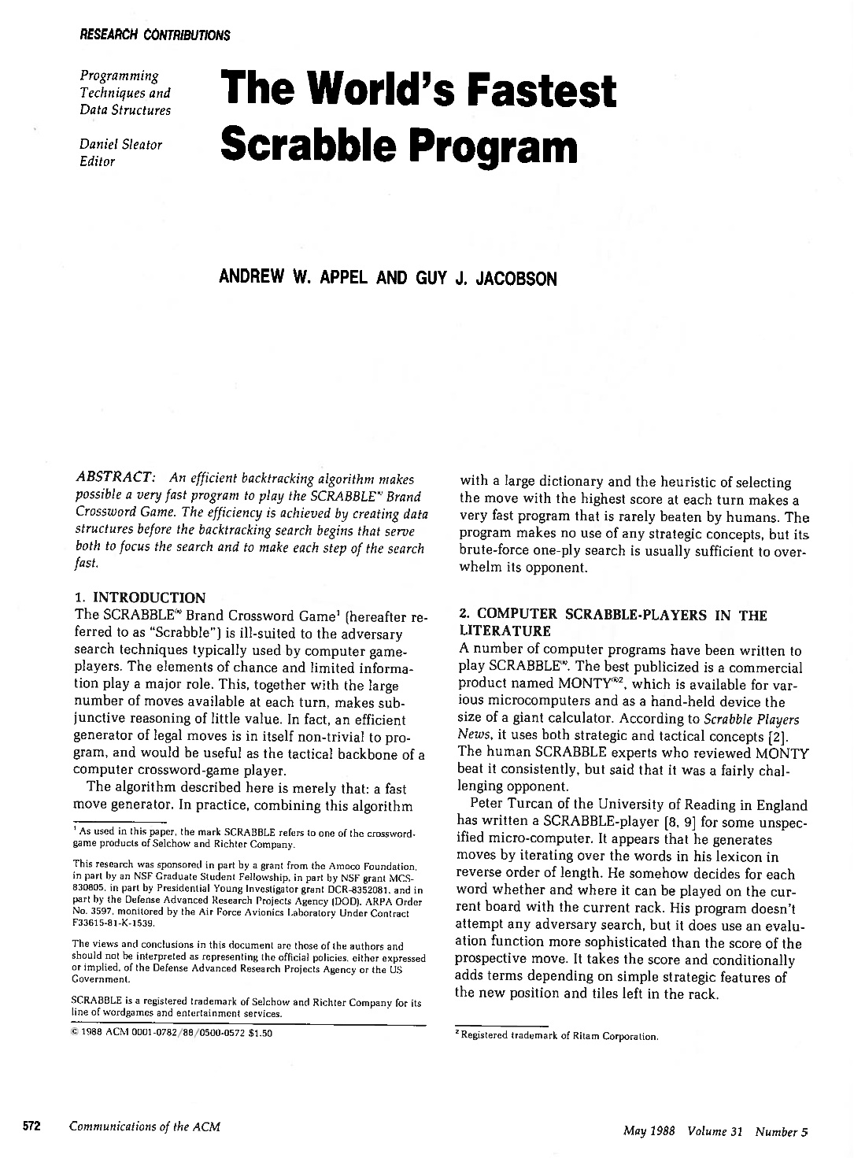
Why Do Both Lexicon and Set Exist?
The Lexicon representation is extremely space-efficient. The data structure used in the library implementation stores the full English dictionary in 350,000 bytes, which is shorter than a text file containing those words.
The underlying representation makes it possible to implement a containsPrefix method that is useful in many applications.
The representation makes it easy for iterators to process the words in alphabetical order.

Slide 42
Iterating over a collection
One of the common operations that clients need to perform when using a collection is to iterate through the elements.
While it is easy to implement iteration for vectors and grids using for loops, it is less clear how you would do the same for other collection types. The modern approach to solving this problem is to use a general tool called an iterator that delivers the elements of the collection, one at a time.
C++11 uses a range-based for statement to simplify iterators:
The Stanford libraries implement the same idea like this:
for (string key : map) {
. . . code to process that key . . .
}
foreach (string key in map) {
. . . code to process that key . . .
}

Slide 43
Iterator Order
When you look at the documentation for an iterator, one of the important things to determine is whether the collection class specifies the order in which elements are generated. The Stanford libraries make the following guarantees:
Iterators for arrays operate in index order.
Iterators for grids operate in row-major order, which means that the iterator runs through every element in row 0, then every element in row 1, and so on.
Iterators for the Map class deliver the keys in the order imposed by the standard comparison function for the key type; iterators for the HashMap class return keys in a seemingly random order.
Iterators for the Set class deliver the elements in the order imposed by the standard comparison function for the value type; the HashSet class is unordered.
Iterators for lexicons always deliver words in alphabetical order.
Notes:
Show PigEnglish, WordFrequency

Slide 44
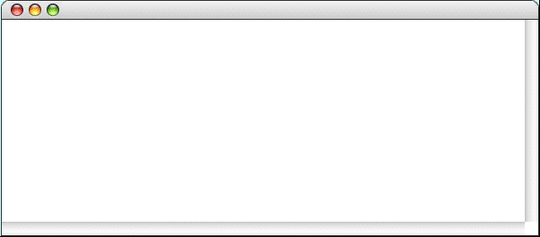
Exercise: Finding Anagrams
Write a program that reads in a set of letters and sees whether any anagrams of that set of letters are themselves words:
FindAnagrams
Enter tiles:
ehprsyz
zephyrs
Enter tiles:
aeinstr
anestri
nastier
ratines
retains
retinas
retsina
stainer
stearin
Generating all anagrams of a word is not a simple task. Most solutions require some tricky recursion, but can you think of another way to solve this problem? Hint: What if you had a function that sorts the letters in a word. Would that help?
Generating all anagrams of a word is not a simple task. Most solutions require some tricky recursion, but can you think of another way to solve this problem? Hint: What if you had a function that sorts the letters in a word? Would that help?
Notes:
Show example: FindAnagrams

Slide 45
The End

